Slide 1
Module 3: From Continental to World Power
Talk | Title | Time Period | Date of Talk
16 | Competing destinies | 1848-1854 | March 4th
17 | The Union falls apart | 1854-1861 | March 18th
18 | Civil War | 1861-1865 | Wednesday April 3rd
19 | Reconstruction & the New South | 1863-1900 | April 15th
20 | Conquest of the West | 1865-1890 | April 29th
18 | Civil War (Repeated) | 1861-1865 | Wednesday May 8th
21 | Triumph of capital | 1865-1900 | May 20th
22 | A world power emerges | 1890-1904 | June 3rd

Slide 2
American History
1
Talk 21: Triumph of Capital 1865-1900
……Part One

Slide 3
Overview
Post Civil War USA
Politics 1876-1888
Robber Barons and the Resistance
Politics 1888-1892
Triumph of Capital 1892-1896
Life 1890s

Slide 4
Post Civil War USA

Slide 5
State of US Economy 1865
South – Economic system in collapse….slow recovery…poor
West- emerging rapidly, source of raw materials to fuel economy
North/ Mid West---perfect conditions for rapid growth
Industrialisation turbo charged…armaments, railroad, oil, steel
Opposition to business interests eliminated
Integrated markets/ economies of scale
USA a United Nation…slavery issue resolved….focus business

Slide 6
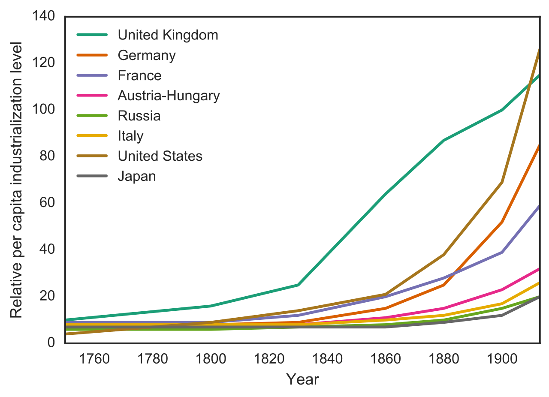
USA: The China of 19th Century
Per Capita Economic Growth 1760 -1914
UK
USA
Germany

Slide 7
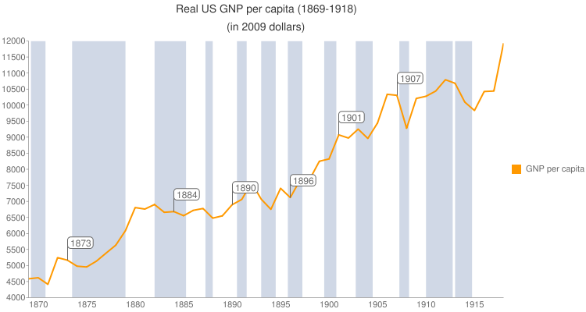
US Economic Growth
Economy grows 2 ½ in 40 years
Panics supress growth …but only temporarily
Population grows from
……..31million 1860
……..80 million 1900
………..High birth rate…optimism
…….12 million immigrants
Panic
Of 1890
Panic
Of 1873

Slide 8
Growth Enablers
High Savings rate…90% capital domestically generated
Cult of individual responsibility
Optimism…balance by insecurity
Growing supply of low cost labour
Surge in immigration …12 million new Americans 1870-1900
Mechanisation of work
Factories: substitution of unskilled for skilled labour
Farms ( agriculture workforce declines from 70% to 50% population)
Supportive Global Financial Network
Foreign Investment (80% British) to key industries (Rail, Steel, Oil)
Acceptance of US tariffs…US too good a place to invest. Britain committed to “Free Trade”

Slide 9
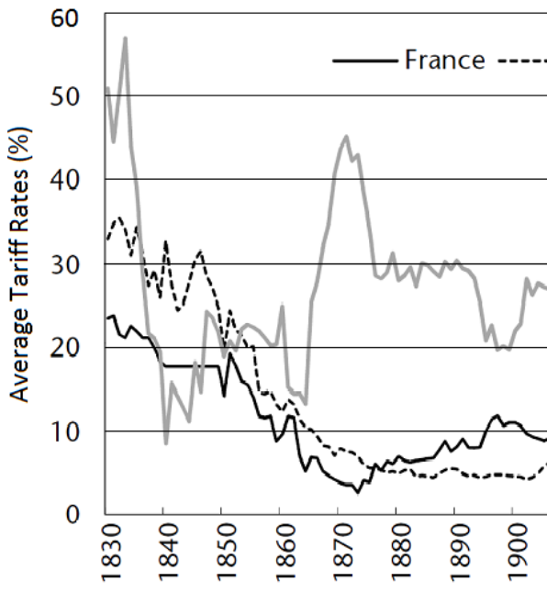
Industrial growth protected by high tariffs (import duties)
US Tariff Rates
British tariff rates
French tariff rates

Slide 10
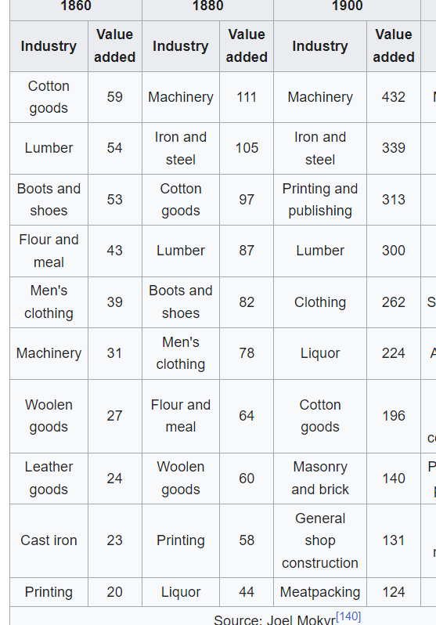
Out with old……….in with the new

Slide 11
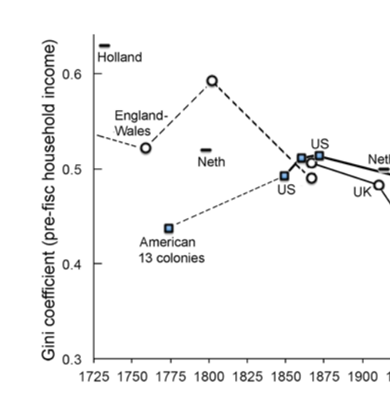
An increasingly unequal Society …..….Gini Coefficient
Colonial US most equal nation on earth
….1% own 8% of wealth (incl slaves)
High inequality
1800-1850….gradual increase
in Inequality….1% - 15% wealth
….huge variation by region
1850-1900…sharp increase
By 1900 1% own 20% wealth
…...US more unequal than Edwardian Britain!
n
Low
Equality

Slide 12
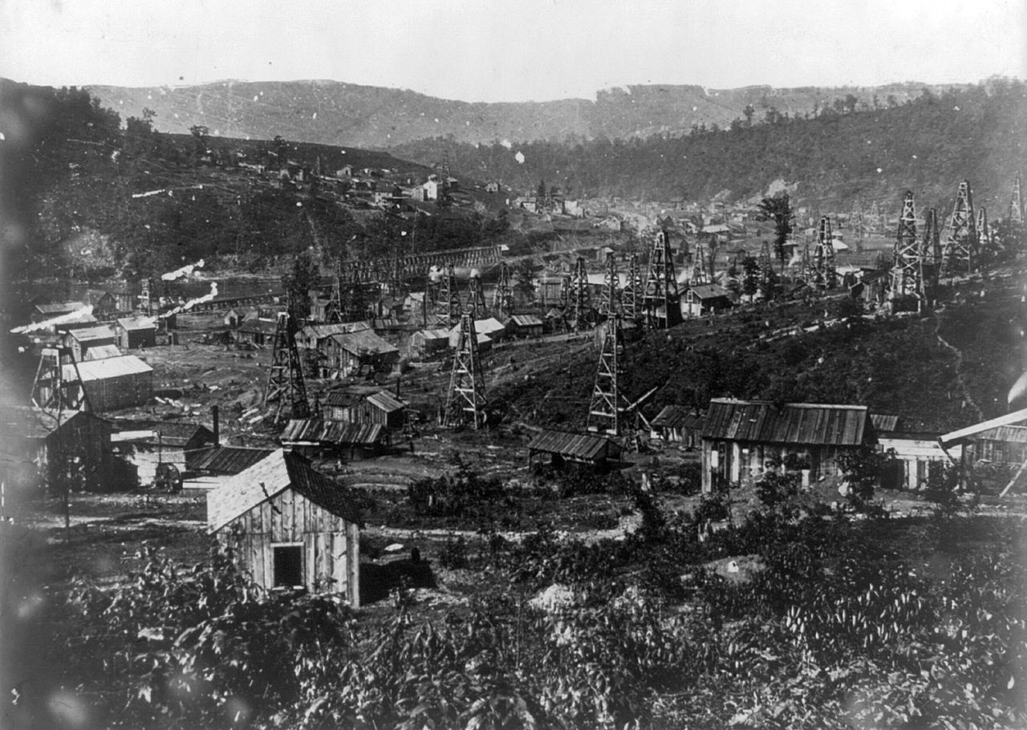
Pennsylvania Oil Field growth driven by industrial demands for lubricants,

Slide 13
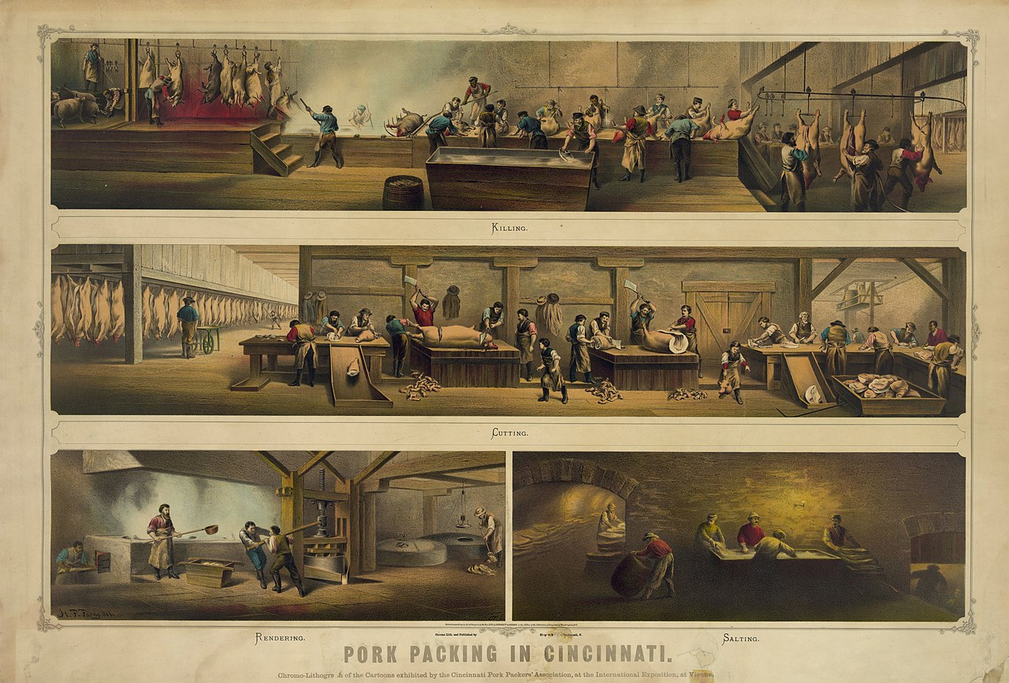
Meat Processing ….Cincinnati

Slide 14
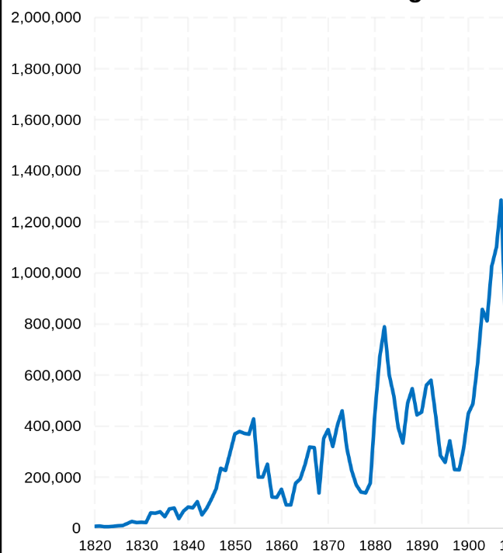
Soaring levels of immigration
98% European
…Asian immigration
banned1882
Wars/ unrest
…..Germany
…..Poland
Poverty
…..Ireland
…..Italy
…..Scandinavia
Potato famine
Revolutions of 1848
Panic 1890
Panic 1873
Civil
War
Opportunity: Britain

Slide 15
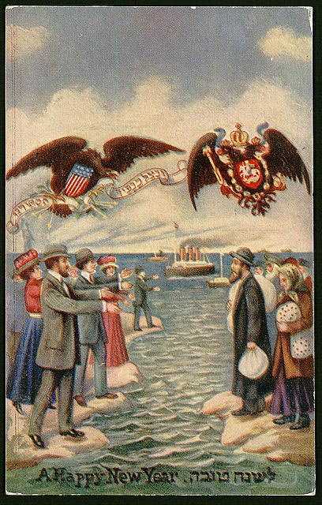
Immigration aggressively promoted

Slide 16
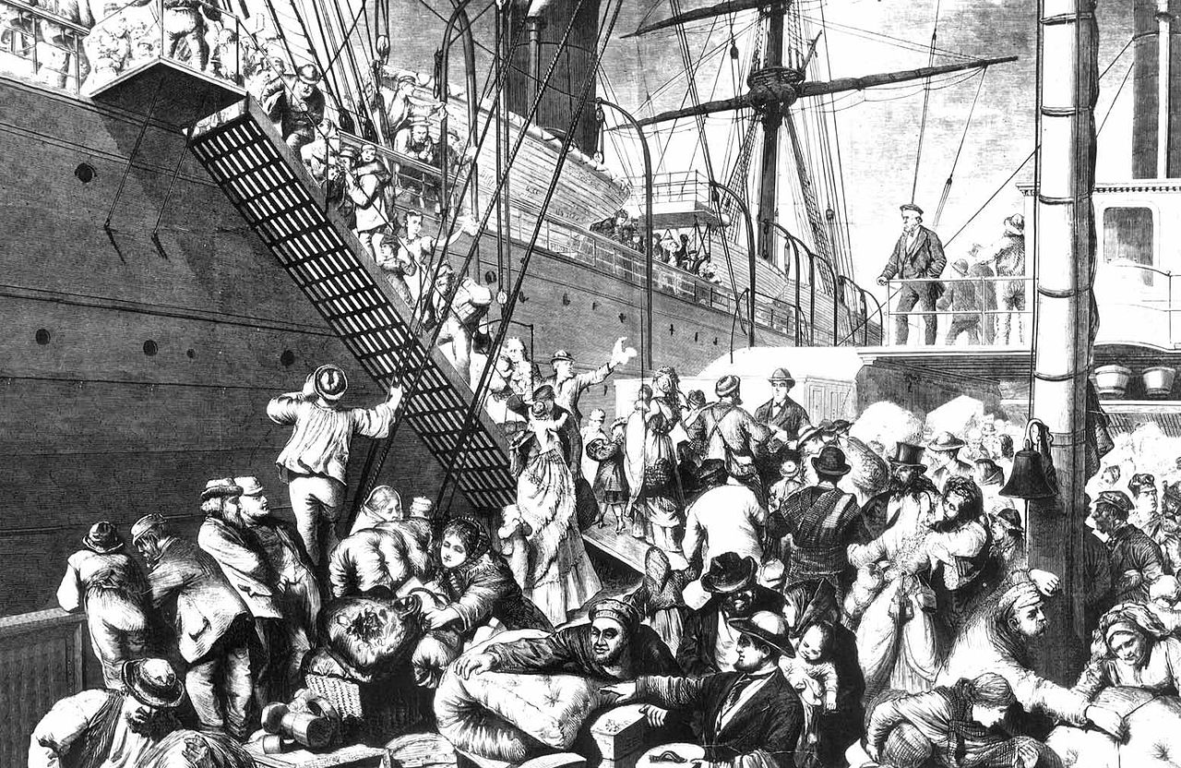
German Immigrants

Slide 17
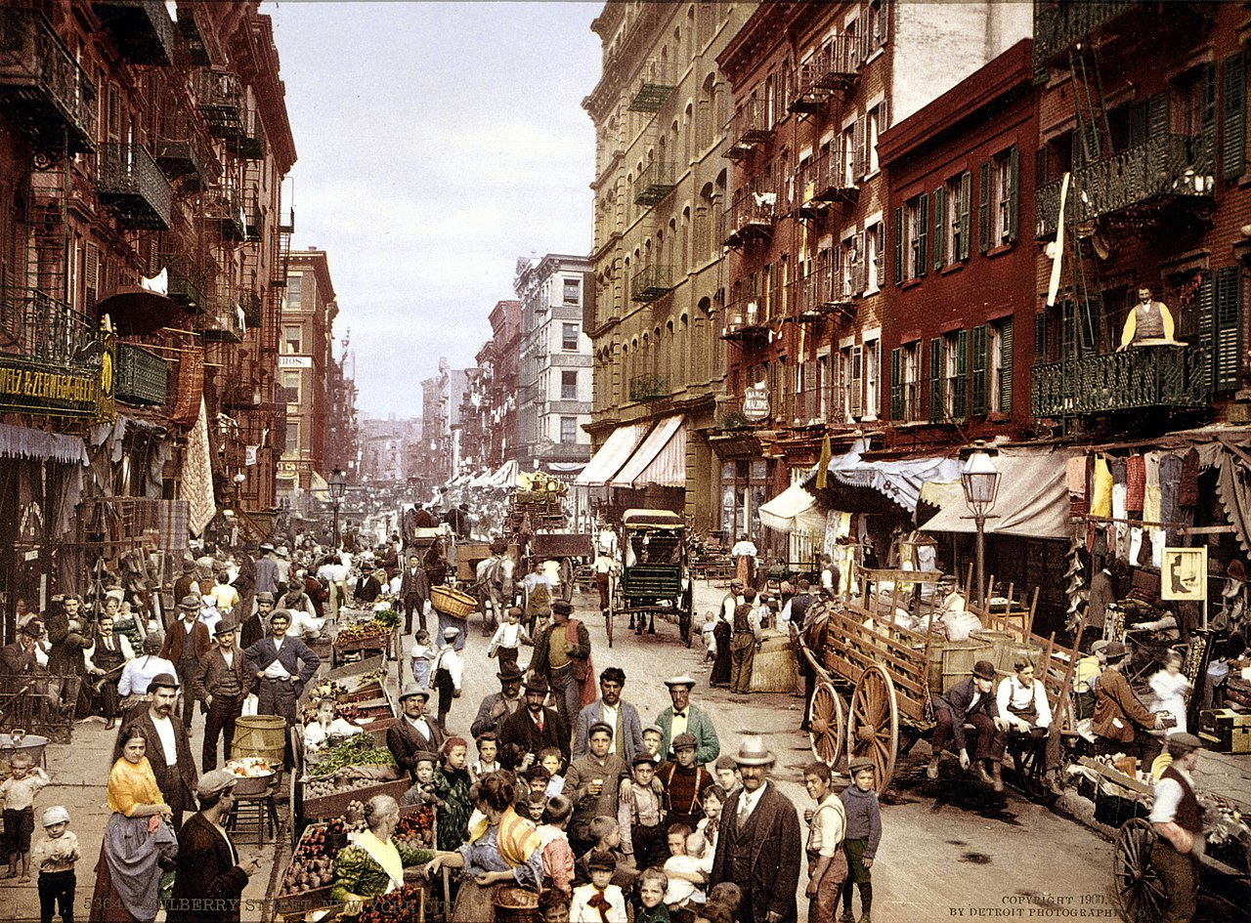
Little Italy New York 1900

Slide 18
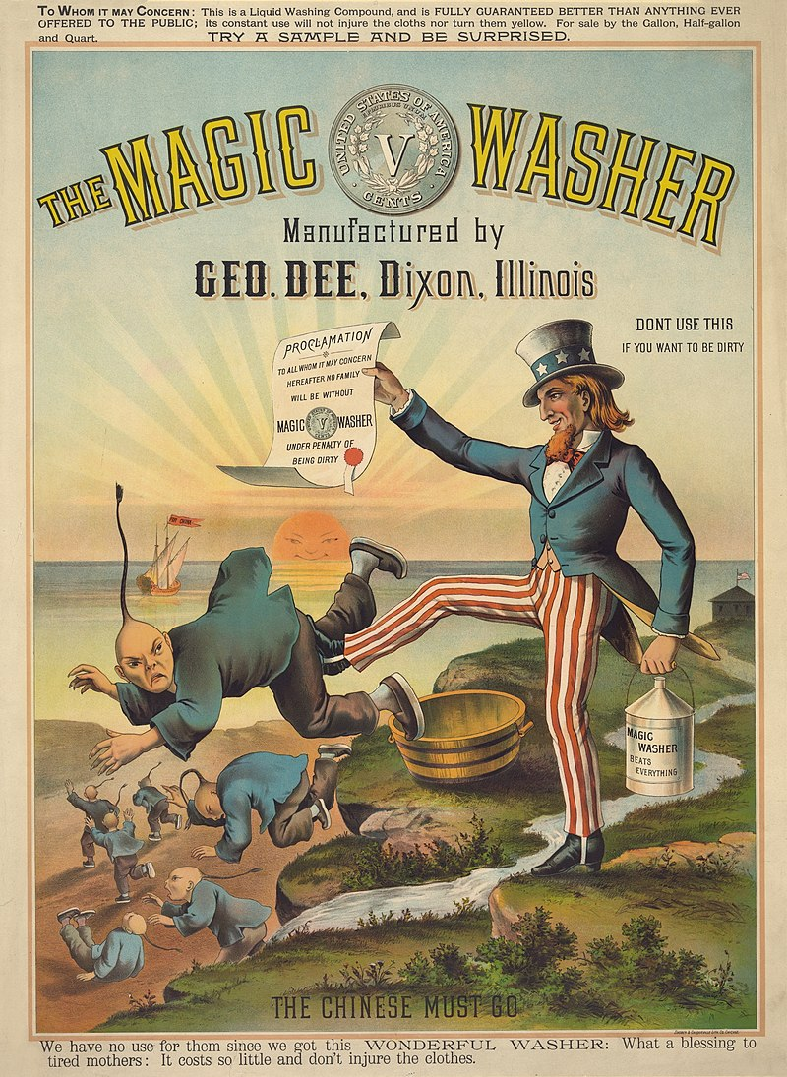
Race Based: Chinese Exclusion Act 1882
Chinese population
…….1848---300
……..1850- 20,000 Gold
……..1880 – 300,000 Railroads & Mining
Los Angeles race riot 1871
…15 hanged by lynch mob
Manifest Destiny
…White supremacy
Exclusion Act
…banned Chinese immigration
..parents “perpetual foreigners”
..Act renewed 1892
…repealed 1952

Slide 19
Politics of power 1876-1888

Slide 20
Political Parties 1876
Republicans:
“Radicals”: Reconstruct the South/ reform government…losing support
“Moderates”: Grow economy/High tariffs/ suppress unions/ pro immigration
Democrats
South: End reconstruction/ White control/ Low tariffs.
North: Small government/ limit immigration/ City ‘machines’
Both Parties committed to economic growth,
….”no constraints/ laws to regulate industry
….opportunities for corruption immense
….

Slide 21
Scandals discredit Republicans
Railroads Credit Mobilier 1867-1870
Financing Union Pacific railroad problematic
Shell Company set up to secure finances
$94 m received, $50m spent, $46m shared wit Credit Mobilier Executive
Whisky Ring – 1870 -1876
Import taxes from whisky diverted to members of cabinet
Grant too loyal…sets up “Anti Corruption
….private secretary leader of “Ring”
Customs Scandal 1880
High tariffs= high excise taxes
Politically appointed managers entitled to “moiety”….diverted to pockets

Slide 22
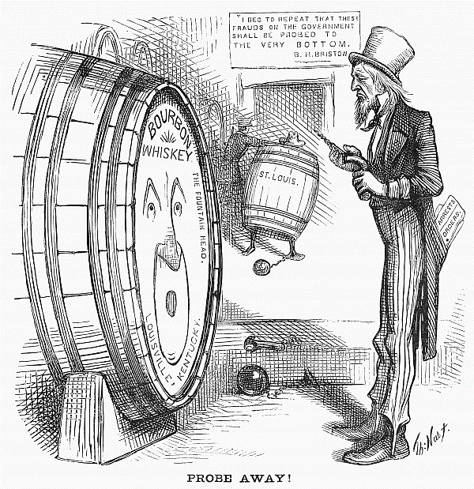
Whisky Ring cartoon

Slide 23
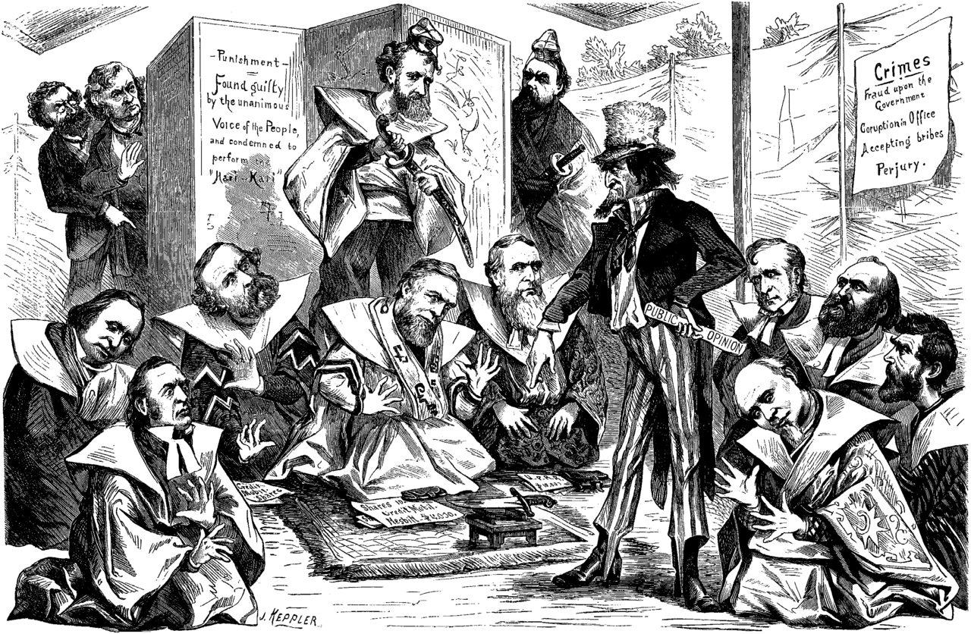
“Uncle Sam”….requesting Senators to commit hari kari

Slide 24
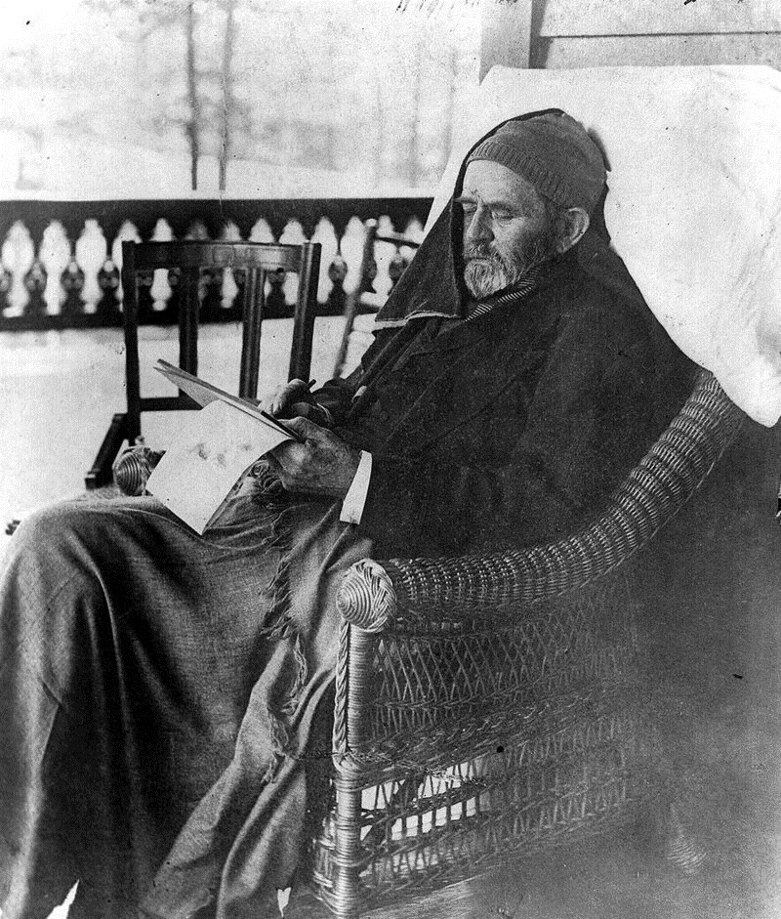
Ulysses Grant ….coda
Leaves office 1876 …discredited
…last day “happiest in my life”
World Tour for 2 ½ years
Celebrated by King, Tsar, Kaiser
Returns ….runs for 3rd term…
Defeated at Convention
Disastrous Mexican railroad scheme
Borrows $140k from Vanderbilt
….Ponzi Scheme bankrupt.
Refuse offer to forgive loan
Penniless…Mark Twain friend… writes Writes memoirs while dying.
…commercial & literary success.
…nation rallies to fund family on

Slide 25
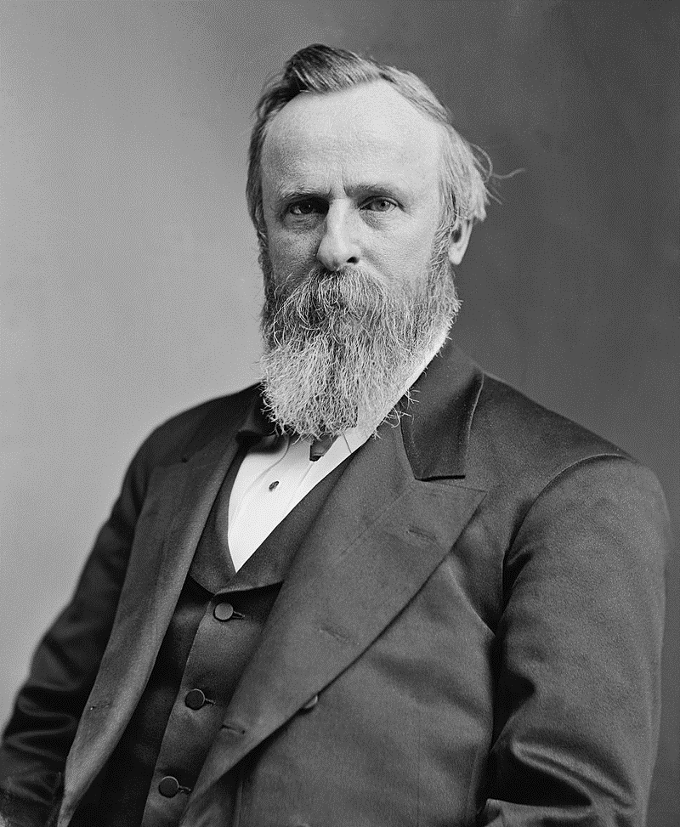
Rutherford Hayes: President 1876-1880
Civil War Hero/ Governor of Ohio
Accepts “deal” of 1876
….abandons Reconstruction
First National Railroad Strike
..railroad vs miners gun fights
deploys army to end Railroad
Strike….stops violence
Attempts to reform government
And bring scandals to end
…blocked by “Stalwarts”
Proposes reforms to Civil Service
….reduce political appointees
…fires incompetent Chester
Arthur…head of Customs Ring

Slide 26
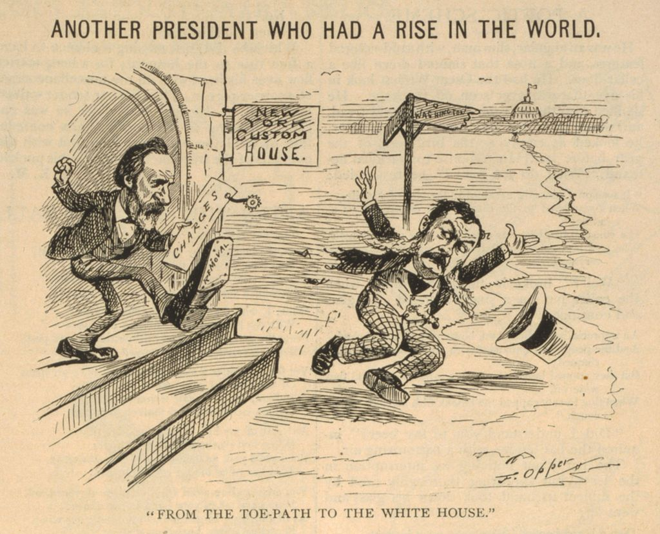
Cleaning up “Customs House”…firing Chester Arthur…Political appointee

Slide 27
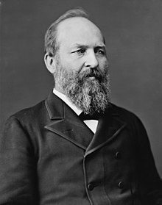
James Garfield: President 1880
Father ditch digger….Civil war hero…Chickamauga
..front line experience
..deeply religious…logician
Mathematician…develops proof
Of Pythagorean system…able to
Write Greek and Latin simultaneously
Seeks to re-impose Reconstruction
Universal public education…reform
Working conditions…civil service
Merit….
Nominated….fired Arthur selected as
VP to balance ticket
Wins election…..”Kennedy moment”

Slide 28
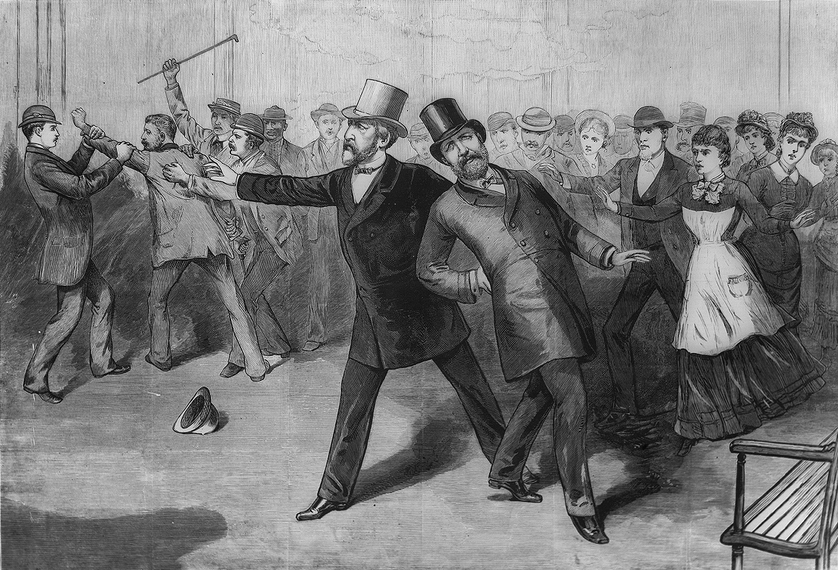
Assassination of Garfield July 1880
Shot by disappointed
office seeker
Dies of infection
….2 months later
Mistaken use of
Metal detector
infection
End of Republican
“Radicals”/ Reconstruction
Chester Arthur
…fired Custom Officer
Becomes President

Slide 29
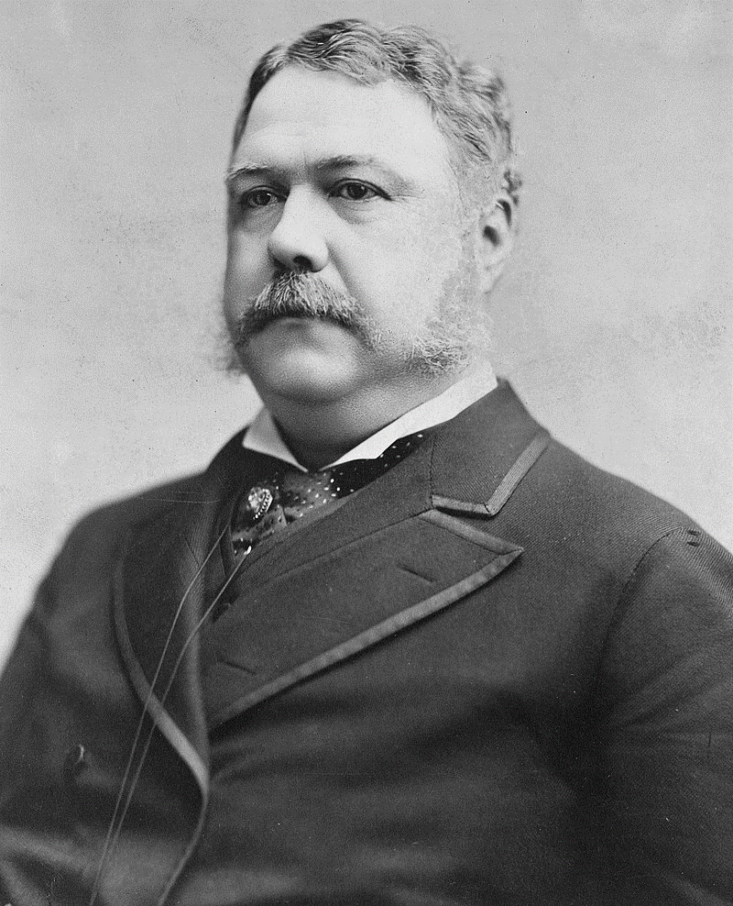
Chester Arthur President 1881-1884
NY lawyer….administrator in Civil War
Political Appointee to Customs Office
….lucrative ….resists reforms. ….fired by Hayes
Appointed VP by “Party Machine”
…to offset Garfield
…no known political views
Shocked at being President commits to Civil Service Reform Pendleton Act
…competency exams
…20% jobs non political
Allows approval of first
Immigration controls…signs but objects
to Exclusion Act vs Chinese

Slide 30
Election of 1884
No substantial differences between parties
….public disgust at corruption vs Republicans
….Democrats….”reborn” Jacksons…small government,
Rising opposition to power of monopolies
…but rising prosperity minimises support for reform
Campaign based on personalities and character

Slide 31
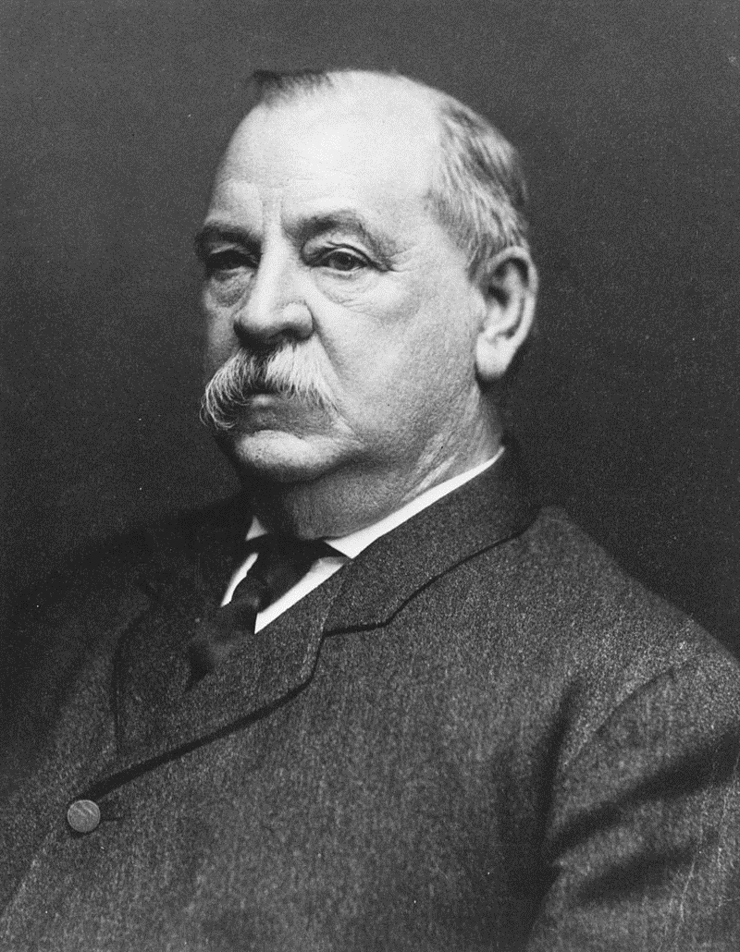
Grover Cleveland (1837-1908)
Father minister…studies law in Buffalo buys Substitute to avoid war service
Mayor…. .reformist, honest, brutal
Hangman to reduce costs! (2 Irish. Disastrous execution. Grover ill
..Batchelor.. boarding house …’affair’ with landlady ..child sued…counter sues…she to Asylum….he supports child..
Reputation for integrity…”Grover the Good”
Governor of NY…vetoes price reduction
For recovered insolvent railroad
Chosen at Democratic Convention
Republican choose Senator Blaine
From Maine….scandal plagued ..letter
on payments exposed….”kindly destroy”

Slide 32
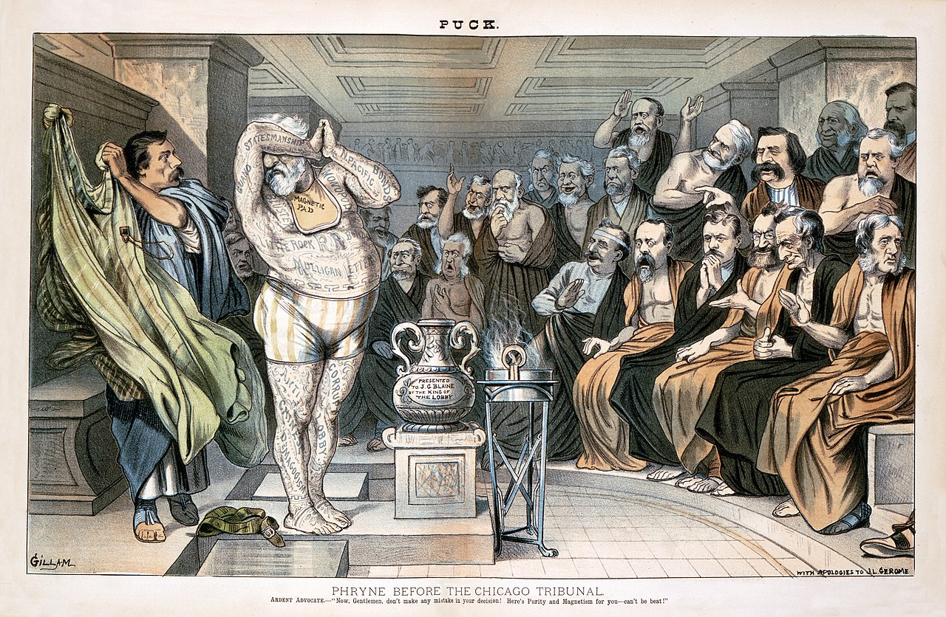
Anti Blaine cartoon….revealing of scandals: “Continental liar from the state of Maine!”
Republican
Group defects
To Dems…
Corruption
“Mugwumps”

Slide 33
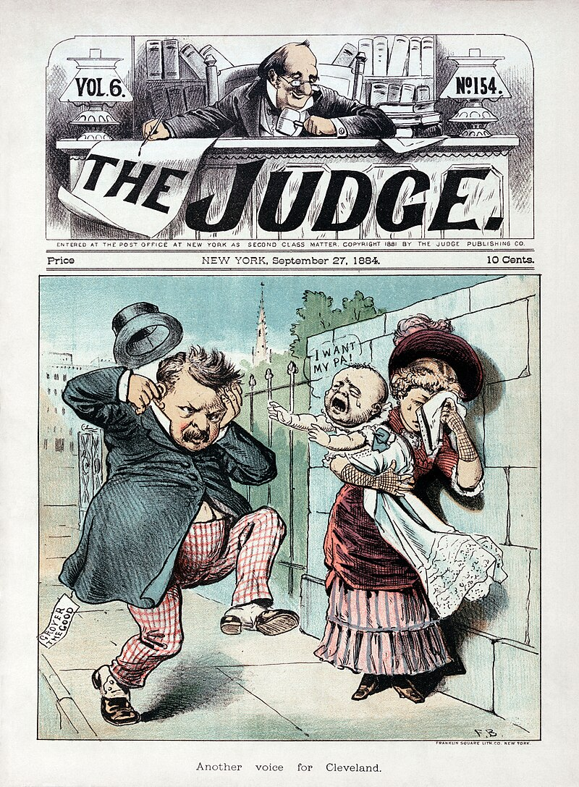
Campaign of 1884…anti Cleveland “Ma, ma, where’s your pa?”..
Republican
Response
“Gone to the
White House
Ha.ha. Ha.”

Slide 34
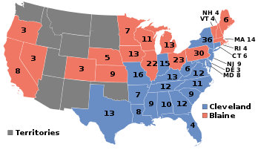
Election of 1884 ….results
Blaine campaigner anti Irish speech “Rome, rum, rebellion!” Cleveland admits
child…”Grover the Good”
Democrats 48.9%...218 electors Republican 48.3%.. 182 electors…South solid Democrat
…NY swing state.
..Unhappy Irish
…split Congress
First Democrat win since war
….Solid South…Immigrants &
emerging labour unions

Slide 35
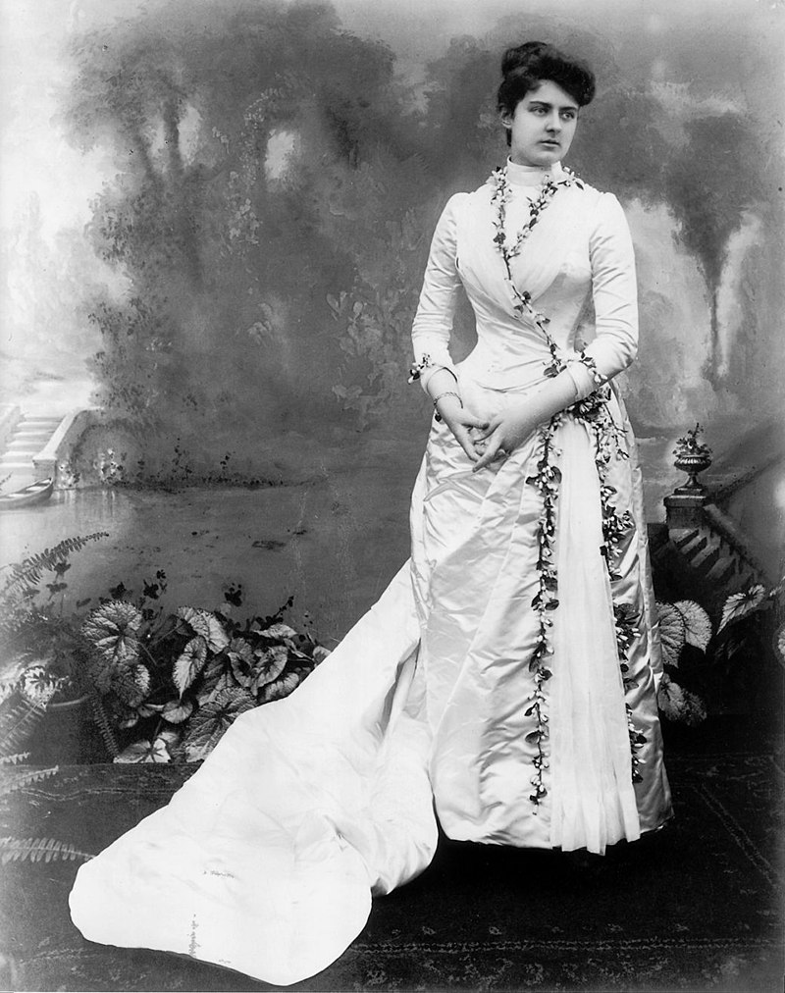
First White House Wedding: Frances Folsom
Grover aged 49 marries
21 year old Frances Folsom
Her father Grover’s law partner
Grover at birth and adopts
Her on father’s death
No scandal at marriage
Frances voted best first lady
…fashion icon
…charities
…out of politics
Remarries on Grover’s death
….friend Eleanor Roosevelt

Slide 36
Cleveland’s First Term 1884-1888
Limited Government…..non interference
Extends Civil Service Reform
Attempts to reduce tariffs….blocked by Congress
Growing resentment vs monopolies and inequality
Wages depressed
Farmers impoverished by railroad pricing, declining food, rising debt for new equipment
Real power has shifted to the monopolists

Slide 37
Robber Barons and resistance

Slide 38
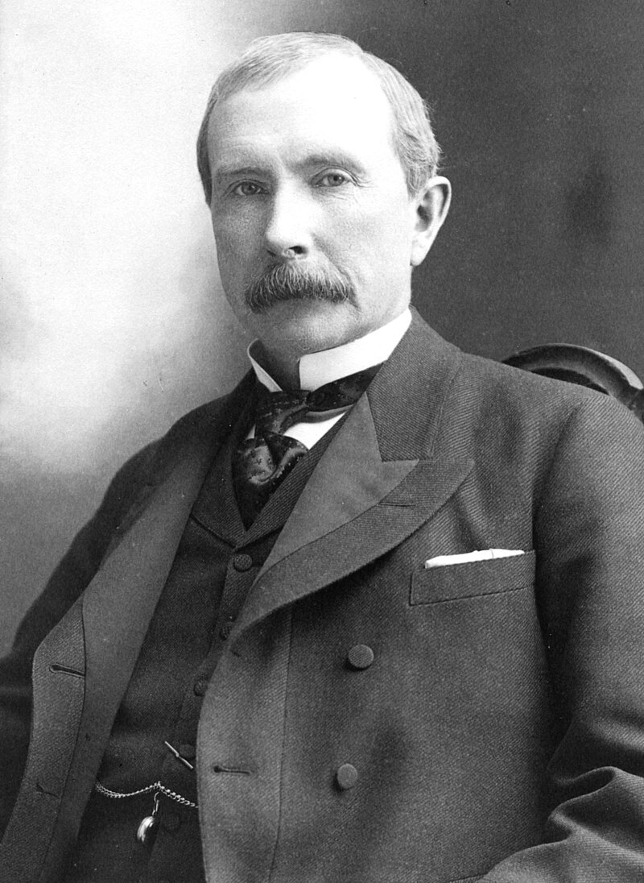
John D Rockefeller (1839-1937)
Son of “snake oil” salesman & Bigamist…mother Eliza devout Baptist mother
2nd…technical college..
Accounting…bookkeeper,
Debt collector, avid saver
Joins produce distribution
Economy savings….business
Booms during civil war. Moves
Into Oil refining (oil price $.35-$14)
Motto: (Wesley) "gain all you can,
save all you can, and give all you can.
Gains profitability through recycling
“waste” to fuel. Scales up, buys out
Competitors, secures preferential
Rates…aggressive pricing
Vertically integrates…oil pump
Pipelines, refiners, distribution
90% of refining market by 1870

Slide 39
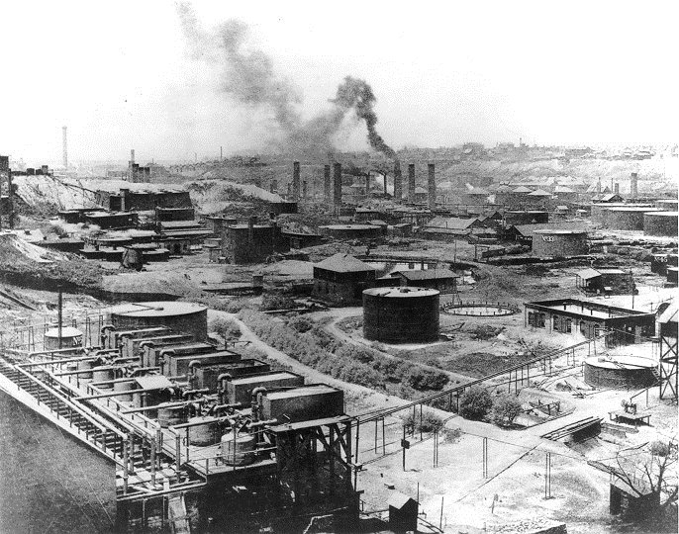
Standard oil refinery 1890

Slide 40
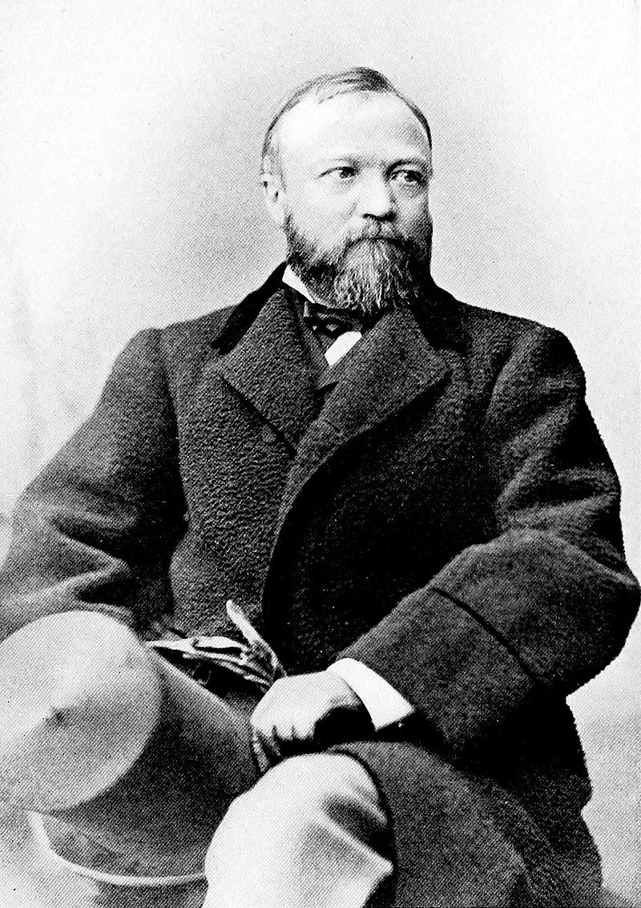
Andrew Carnegie (1835-1919)
Born Dunfermline. Son of
Weaver. Reads in library
Of Boss…To US 1848
Works a factory boy...become
Telegraph operator, memorises
Rates….rises to messenger boy
For Pennsylvania railway.
Learns deals, trusted by boss
Speculates based on information
..accumulates capital
Rises…company merges with
Pullman Sleeper cars…moves
Troops…sees demand for iron
& steel…buys steel company
Adopts Bessemer (heat oxides
Iron ore cheaply…steel) process fast
…secures rail rebates, buys out
Competitors by cash/ discounts
Focus on efficiency, anti unions
…delegates control to “thugs”

Slide 41
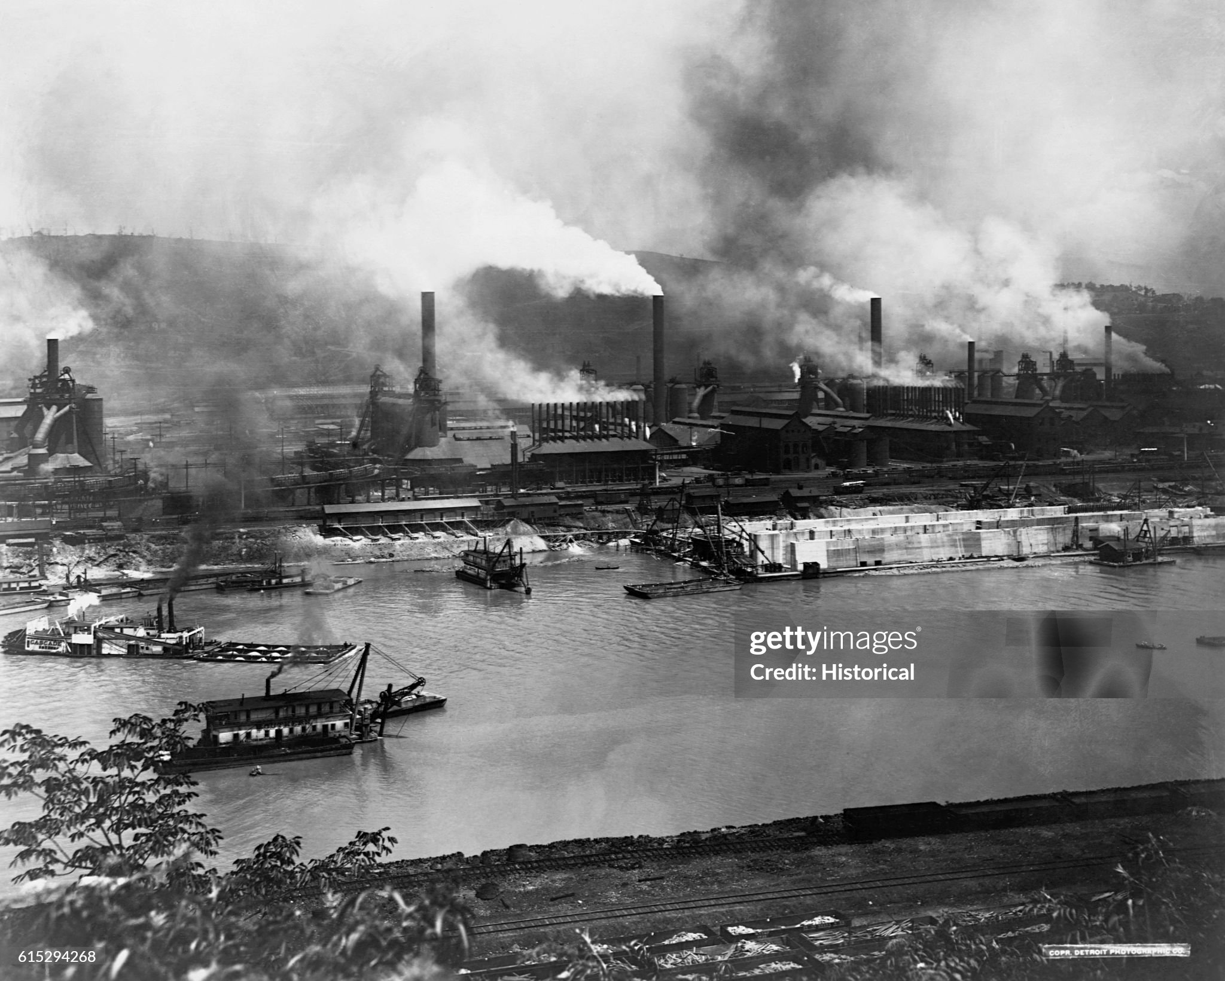
Carnegie steel works 1890

Slide 42
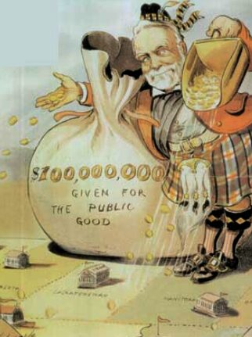
Carnegie: the legacy
Wealthiest man in world
By 1890..$1Trillion 2024
Writes “Gospel of Wealth”
…purpose of life gain wealth
Then gives it away
Sells out to JP Morgan
Funds libraries, swimming
Baths US and US
Staunch anti monarchist.
Believes alliances US and
Britain…popular…establishes
University of Birmingham!
Opposes war…and
Imperial wars of US yet
to come.

Slide 43
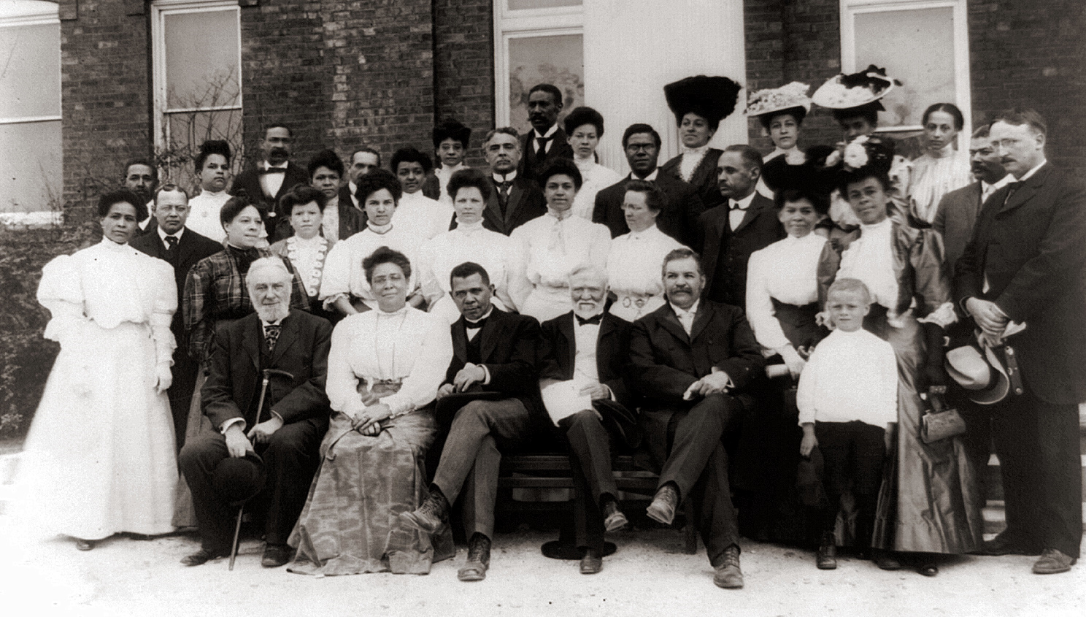
Carnegie & Booker T Washington
Meets and supports
Booker T Washington
Funds Tuskegee Institute
Establishes Negro Business
League in New York..
Funds education across
Unable to give away
All wealth. Sets up
Carnegie Foundation

Slide 44
Other monopolists
Monopolists
Jay Gold….railroads…wall street trader
Cornelius Vanderbilt….steam ships and railroads
James Fisk….wall street
JP Morgan…banker and financier
Trusts
Jointly owned companies nominally independent
Set prices, wage, competition, blacklist workers
Convert economic to political power.
Use of force/private armies to crush strikes

Slide 45
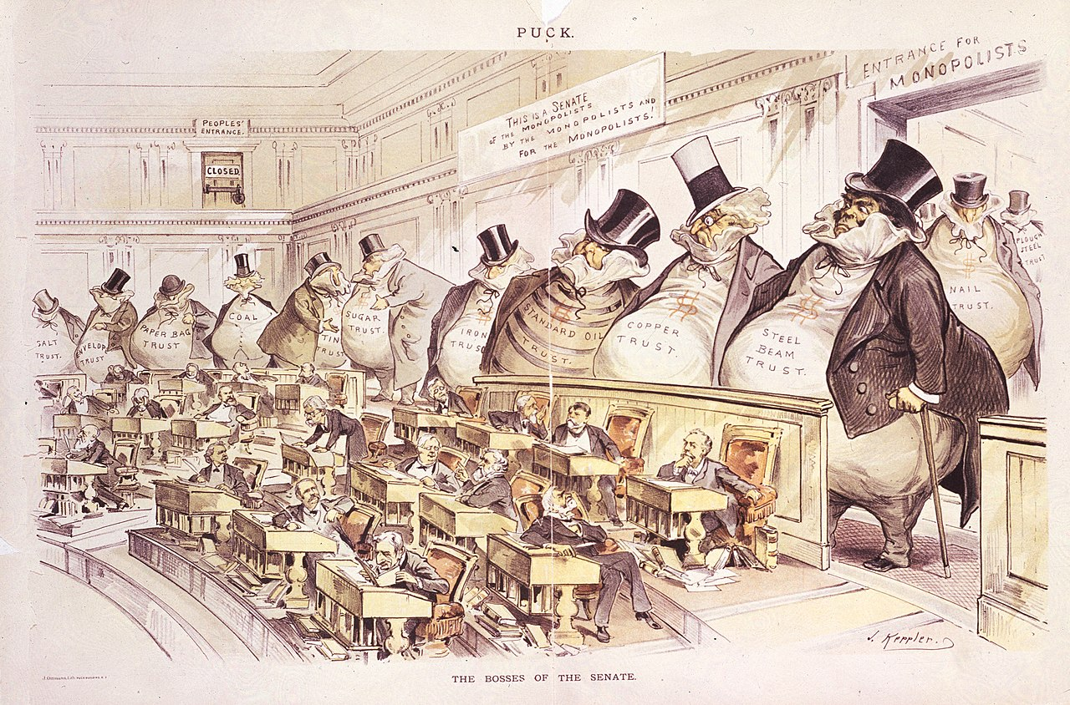
The Trusts and the Senators

